Slide 1
Security
Some thoughts on how to be safe in cyberspace

Slide 2
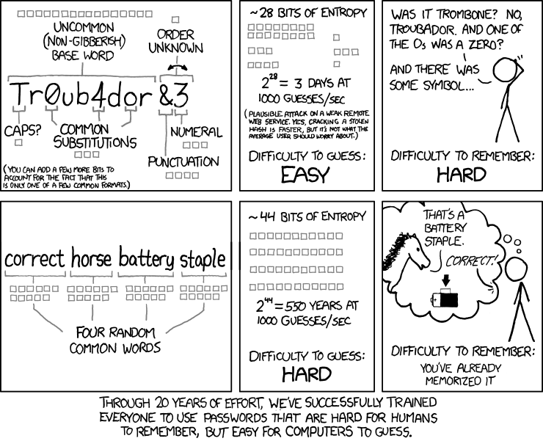
Passwords

Slide 3

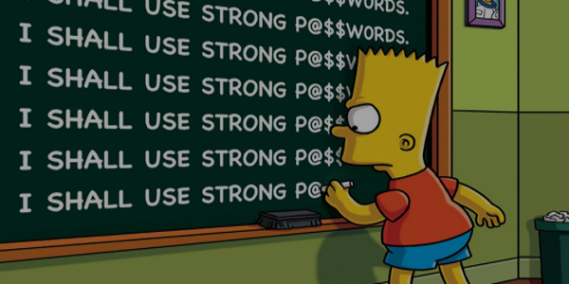
The Bottom Line
The most important factor is password length.
The longer the password, the better.
But also use different passwords for different services (especially critical services)
Notes:
8 character passwords can be cracked in 2.5 hours.

Slide 4
Password Priority
Does your student email need to be as secure as your bank account?
Practical Considerations are also Important
Do you need to remember this password or not?

Slide 5
Ways to Keep Track
Write them down?
Throwaway Passwords
Social Auth
Single Sign-On (SSO)
Use a password vault
The Future: FIDO (Fast IDentity Online)
Notes:
SSO is typically for companies.
Password vaults:
* Dashlane, keepass, iCloud keychain,

Slide 6
A possible solutions
Diceware System
Pros/Cons?
Password Vault
LastPass
Keepass
Dashlane
Pros/Cons?

Slide 7
2 factor Authentication
What is Authentication?
Factors:
Something you know
Something you have
Something you are
Prove your identity
Examples?

Slide 8
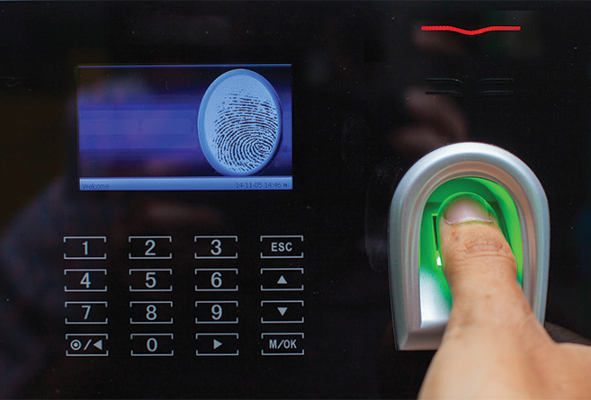
What About Biometrics?
Passwords Are Out (Almost)
Alternatives:
Voice recognition
Face recognition
Fingerprint/retinal scans
How secure are biometrics?
Notes:
There are ways to secure biometric data.
Working on ways to counter spoofs

Slide 9
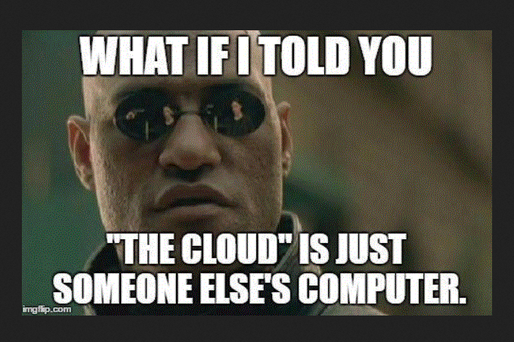
How to protect your computer
Anti-”virus” software
Best Practices
Vigilance

Slide 10
Malware Scanners
The Main Three
The Others
Windows Defender
Malwarebytes
SUPERAntiSpyware
BitDefender
Avast Free
Ad-Aware Free
AVG Free
Avira
Panda Dome
Kaspersky (Russian)

Slide 11
NEVER INSTALL Norton or Mcafee
Never install Norton or McAfee

Slide 12
Internet General Rules
Never give out your password!
Covet your personal information?
Never meet in person?
Be aware of advertisements. (clickjacking)
Check your sources.
Be wary of emails (even from friends)

Slide 13

What about kids?
Communication
Act as if you’re in the real world.
Do you trust your kids?
Beware of Strangers Bearing Gifts
Once you’ve written something, you can’t delete it.
Vigilance and monitoring
How much do you tell them?
Social Media?
Notes:
Early and often.
This will also help prevent your kids from becoming trolls. Teens NEED to understand that everything they do online is forever. Teach kids about privacy settings.
How much should you trust/limit kids’ access to the web? AV software? Filters?
Kids should understand that hackers are just like criminals except they break your computer and not windows.
It doesn’t matter what the law says. Beyonce cannot get rid of that picture.
Credit reports?

Slide 14
Top Cyber Attacks
Malware
Unpatched Software
Phishing Attacks
Main-In-The-Middle
Denial-of-service
Zero-Day Exploit
Notes:
Sorts of things malware does
Java, Adobe, etc
Email. Spearphishing (social engineering as well)
Unsecured wifi, things like that.
Flood systems with requests
Stay informed.

